Slide 1
BASIC IONIC TAGS

Slide 2
Ionic Tags
Ion-app
Ion-content
Ion-menu
Ion-input
Ion-button
Ion-textarea
Ion-img

Slide 3
Ion-app
App is a container element for an Ionic application.
There should only be one <ion-app> element per project.
An app can have many Ionic components including menus, headers, content, and footers.
The overlay components get appended to the <ion-app> when they are presented.

Slide 4
Ion-header
Header is a parent component that holds the toolbar component.
It's important to note that ion-header needs to be the one of the three root elements of a page

Slide 5
Ion-content
The content component provides an easy to use content area with some useful methods to control the scrollable area.
There should only be one content in a single view.
Content, along with many other Ionic components, can be customized to modify its padding, margin, and more using the global styles provided in the CSS Utilities or by individually styling it using CSS.

Slide 6
Example-1
<ion-header>
<ion-title>
Registration form
</ion-title>
</ion-header>

Slide 7
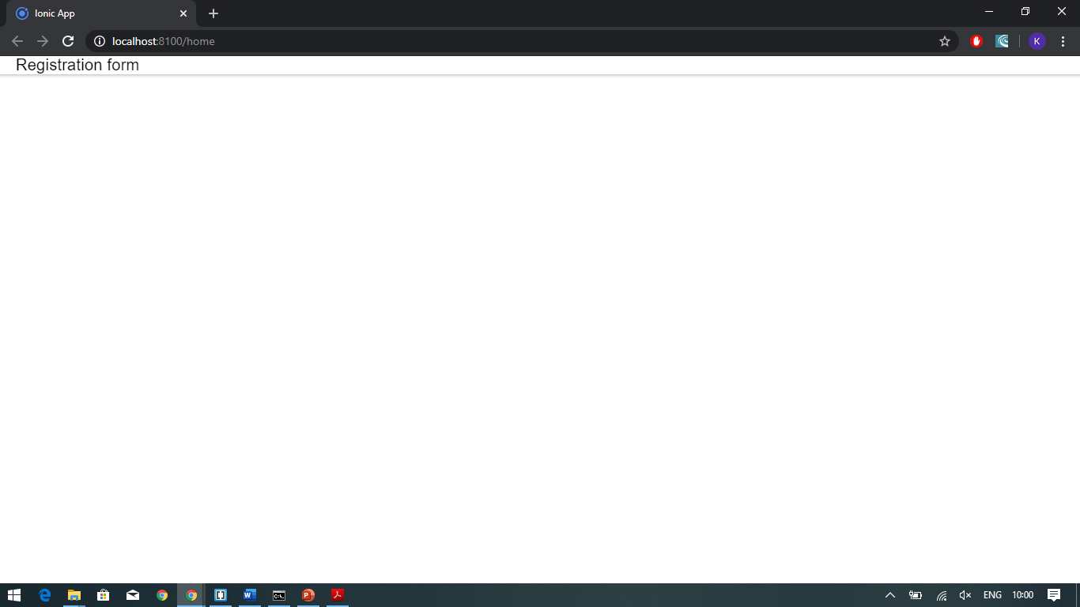

Slide 8
Example-2
<ion-header>
<ion-toolbar>
<ion-title>
Registration form
</ion-title>
</ion-toolbar>
</ion-header>

Slide 9
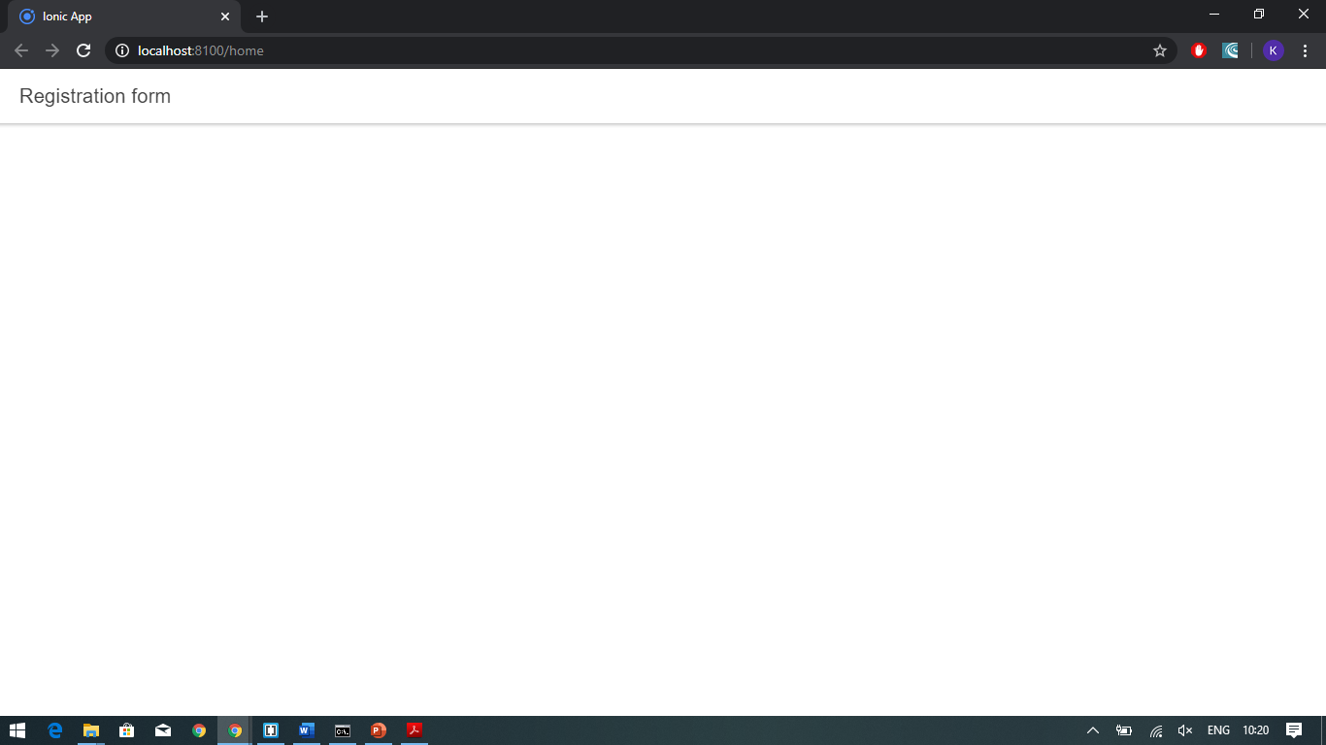

Slide 10
Example-3
<ion-header>
<ion-toolbar color="primary">
<ion-title>
Registration form
</ion-title>
</ion-toolbar>
</ion-header>
Different colour classes available are:
Primary
Secondary
Danger
Tertiary
Success
warning

Slide 11
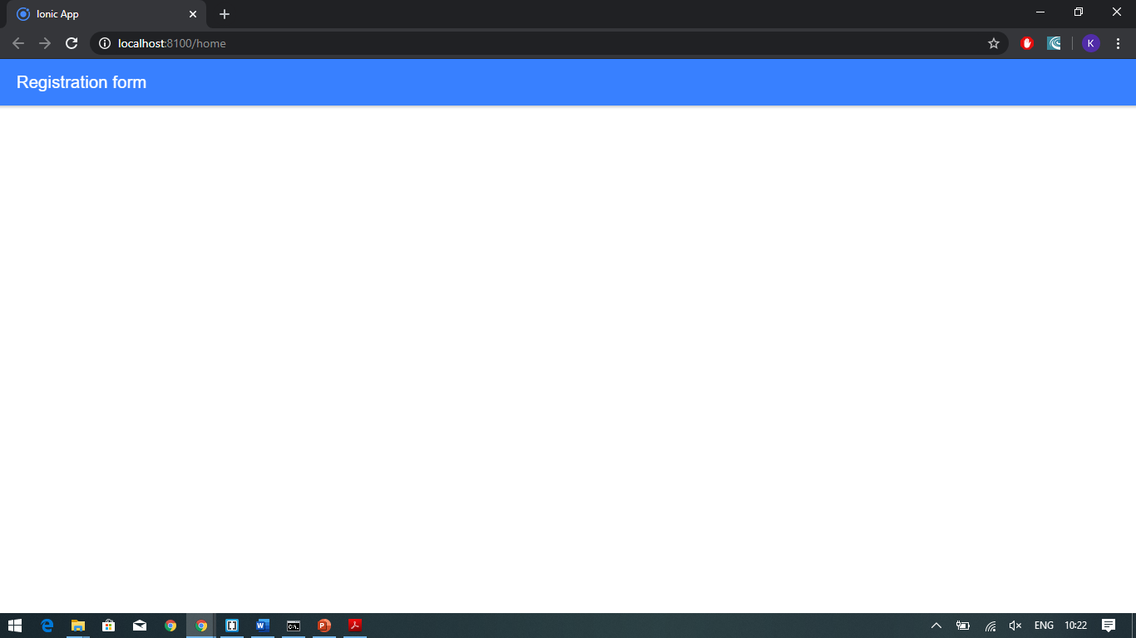

Slide 12
Example-4
<ion-content>
<form>
<ion-label>User Name<ion-text color="danger">*</ion-text> </ion-label>
<ion-input type="text" required></ion-input>
<ion-label>Password<ion-text color="danger">*</ion-text> </ion-label>
<ion-input type="text" required></ion-input>
<ion-button name="">login</ion-button>
</form>
</ion-content>
<ion-header>
<ion-toolbar color="warning">
<ion-title>
Login Form
</ion-title>
</ion-toolbar>
</ion-header>

Slide 13
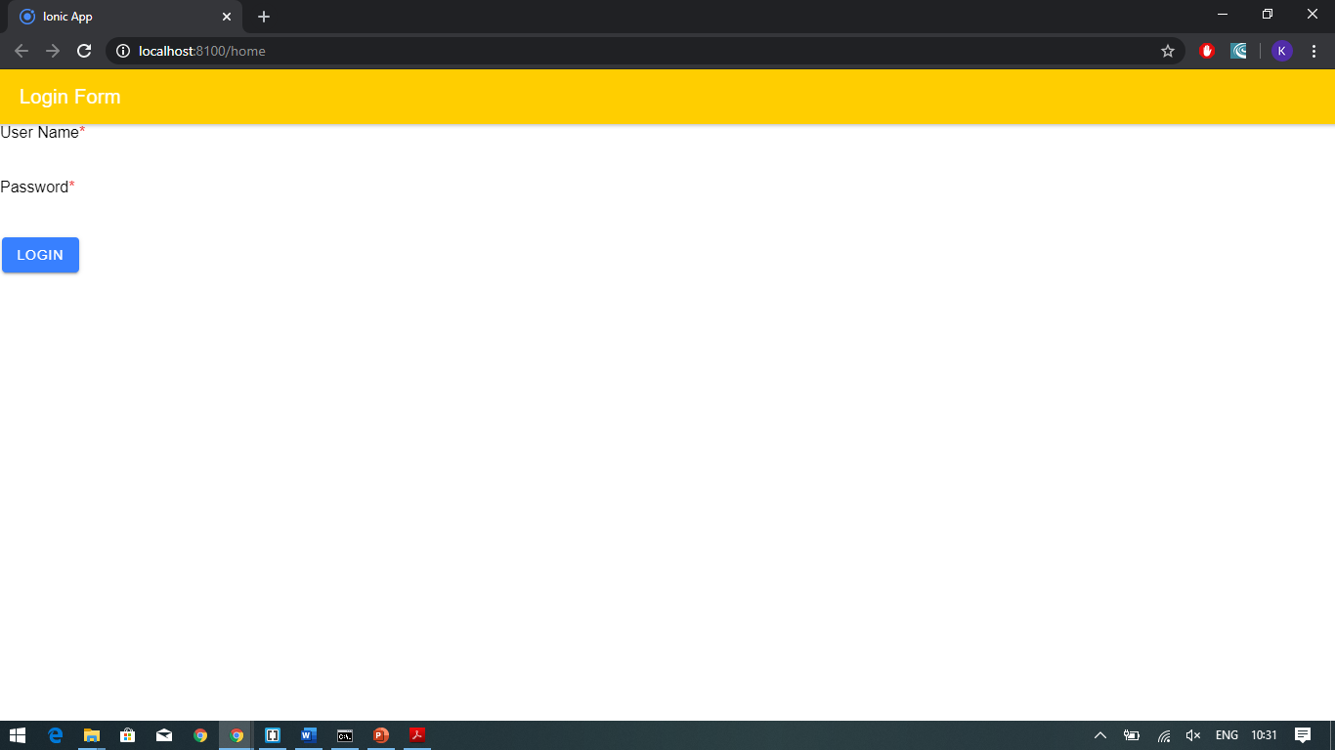

Slide 14
Example-5
<ion-item>
<ion-label >User Name<ion-text color="danger">*</ion-text> </ion-label>
<ion-input type="text" required></ion-input>
</ion-item>
<ion-item> <ion-label>Password<ion-text color="danger">*</ion-text> </ion-label>
<ion-input type="text" required></ion-input> </ion-item>
<ion-button name="">login</ion-button>
</form>
</ion-content>
<ion-header>
<ion-toolbar color="warning">
<ion-title>
Login Form
</ion-title>
</ion-toolbar>
</ion-header>
<ion-content>
<form>

Slide 15
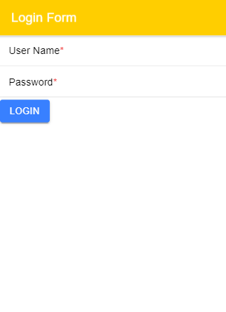

Slide 16
Example-6(home.page.html)
<ion-item>
<ion-label position=floating>Second value
</ion-label>
<ion-input type="text" [(ngModel)]="n2"></ion-input>
</ion-item>
<ion-item>
<ion-label>Sum is {{sum}}
</ion-label>
</ion-item>
<ion-item>
<ion-button (click)="addition()">sum</ion-button>
</ion-item>
</ion-content>
<ion-header>
<ion-toolbar color="warning">
<ion-title>
Addition
</ion-title>
</ion-toolbar>
</ion-header>
<ion-content>
<ion-item>
<ion-label position=floating>First value
</ion-label>
<ion-input type="text" [(ngModel)]="n1"></ion-input>
</ion-item>

Slide 17
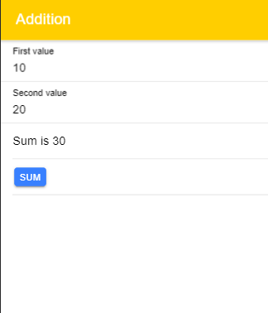
Script code(home.page.ts)
import { Component } from '@angular/core';
@Component({
selector: 'app-home',
templateUrl: 'home.page.html',
styleUrls: ['home.page.scss'],
})
export class HomePage {
public n1:any=10;
public n2:any=20;
public sum:any=0;
addition()
{
this.sum=this.n1 + this.n2;
}
}

Slide 18
APPLICATION-1
Check your friendship bond…

Slide 19


Slide 20
Coding(html page)
<ion-item>
<ion-label position="floating">Your's Friend Name</ion-label>
<ion-input type="text" [(ngModel)]="name2"></ion-input>
</ion-item>
<ion-button expand="full" color="warning" (click)="getResult()">Get Result </ion-button>
<ion-card align="center">
{{name1 || 'Name1' }} and {{name2 || 'Name2'}}
<p style="font-size:200%" align="center">
{{this.sum}}%
</p>
</ion-card>
</ion-content>
<ion-header>
<ion-toolbar color="tertiary">
<ion-title text-center>
Check your friendship bond...
</ion-title>
</ion-toolbar>
</ion-header>
<ion-content padding>
<ion-item>
<ion-label position="floating">Your's Name</ion-label>
<ion-input type="text" [(ngModel)]="name1"></ion-input>
</ion-item>

Slide 21
Angular Code
import { Component } from '@angular/core';
@Component({
selector: 'app-home',
templateUrl: 'home.page.html',
styleUrls: ['home.page.scss'],
})
export class HomePage {
public name1:any='';
public name2:any='';
public sum:any;
getResult()
{
const letters=(this.name1+this.name2).toLowerCase();
this.sum=0;
for (let i=0;i<letters.length;i++)
{
this.sum+=letters.charCodeAt(i);
}
this.sum= this.sum%101;
}}

